Slide 1
CSc 598.66
CAPSTONE I: ETHICS, MANAGEMENT & ECONOMICS
Department of Computer Science
City College of New York
Fall 2017
Copyright © 2017 by Abbe Mowshowitz

Slide 2
TOPIC 7. ECONOMICS AND MANAGEMENT OF SOFTWARE
OVERVIEW
Economics of software development
Outsourcing and offshoring
Cloud computing

Slide 3
ECONOMICS AND MANAGEMENT OF SOFTWARE
Economics of software development
Software economics lies in intersection of information economics and software engineering

Slide 4
ECONOMICS OF SOFTWARE DEVELOPMENT
A.1. Software economics in context
a. Information economics dates from 1960’s
- economics of advertising
- search for best prices
- economics of investment
- economics of knowledge industry (Machlup, Porat)

Slide 5
ECONOMICS OF SOFTWARE DEVELOPMENT
b. Economics of computers (early days)
- buying vs. leasing computer systems
- pricing computer services
- economies of scale in systems
c. Software development costs (models first proposed in 1970s and 1980s)
- software risk management (statistical decision theory to determine how much to pay for risk-reducing information)

Slide 6
ECONOMICS OF SOFTWARE DEVELOPMENT
c. Software development costs (cont.)
- risk & product value considerations
- “design for change” approach (focus on evolutionary aspects)
- software re-use
- schedule estimation

Slide 7
ECONOMICS OF SOFTWARE DEVELOPMENT
d. Problems in software economics
i. Inadequacy of classic schedule estimation formula
# calendar months = mean staff size
X cube root of person-months
- captures only direct cost of resources
- fails to take account of opportunity cost of delay in competitive market
E.g. mean staff 3, person-months 27 gives 3 x 3 = 9

Slide 8
ECONOMICS OF SOFTWARE DEVELOPMENT
ii. Real option approach
(a) view product as real option (like stock option)
- shipping = exercising option
- entry of competitor = sharp drop in underlying stock price
(b) quantifying time to market pressure
(c) Solution to above example: 5.2 people for 5.2 months or 6 people for 4.5 months

Slide 9
ECONOMICS OF SOFTWARE DEVELOPMENT
iii. Basics of real options
(a) option gives right to make future, investment, with no obligation to do so
(b) option has present value (can pay off but need never be a loss)
(c) module creates opportunity to invest in search for superior replacement
- buys designer option to replace with best alternative
- keep current one if still best

Slide 10
ECONOMICS OF SOFTWARE DEVELOPMENT
iii. Basics of real options (cont.)
(d) value of module/option
- optimal experiment-and-replace policy adds value
- knowing value helps designer reason about
-- initial investment in modularity
-- effort to expend searching for alternatives
(e) analogy with stock options imperfect (may be no underlying market traded asset)

Slide 11
ECONOMICS OF SOFTWARE DEVELOPMENT
A.2. Commercialization of software development
- shift from large government projects to commercial activity (end of cold war, new technology, globalization)
- impacts of software-enabled change are more pervasive (e.g., e-tailing)
- greater awareness of value creation as final arbiter of success
- infrastructure investments (e.g., amazon)
- competition for prestige (e.g., Intel vs. AMD)

Slide 12
ECONOMICS OF SOFTWARE DEVELOPMENT
A.3. Measuring the value of software
i. Choosing a model
- decision theory
- classical corporate finance
- real options
ii. Identifying stakeholders
- who is doing the valuing? (type of player)
- what does stakeholder value?

Slide 13
ECONOMICS OF SOFTWARE DEVELOPMENT
iii. Challenges
- autonomous agents: control problems
- commercial off the shelf components: uncertainty about components

Slide 14
ECONOMICS OF SOFTWARE DEVELOPMENT
B. Improving software economics in the firm
Data for better estimates, dynamic management .
1. Modeling costs, benefits and value
a. problem of measurement
- function points at different language levels
- source lines of code: estimating cost
- either ok if all done at same language level

Slide 15
ECONOMICS OF SOFTWARE DEVELOPMENT
a. measurement (cont.)
- neither lines of code nor function points useful for bottom-line productivity
-- behavioral problem: “one gets what one measures”
-- program size in any dimension may say nothing about organizational productivity
b. benefits are domain specific (e.g., time value of information is not the same for stock exchange, factory, farm, etc.)

Slide 16
ECONOMICS OF SOFTWARE DEVELOPMENT
2. Relating benefits to costs
a. cost avoidance (e.g., software investments and re-usable components)
b. time to market and market share
c. uncertainty & risk (reduce with information)
- demand, supply and price
- critical stakeholders or early adopters
- technology & economic conditions
- competition

Slide 17
ECONOMICS OF SOFTWARE DEVELOPMENT
3. Software Project Tracking and Oversight
- tracking according to documented plan
- reviewing and controlling commitments
- tracking & if necessary correcting: software size, effort, cost, computer resources, schedule risks
- recording data
- performing periodic internal project reviews

Slide 18
ECONOMICS OF SOFTWARE DEVELOPMENT
4. Opportunities for improvement
a. achievements to be monitored & controlled by means of
- business value concepts
- business case analysis

Slide 19
ECONOMICS OF SOFTWARE DEVELOPMENT
b. corrective actions to be performed in case of shortfalls
i. reorganize process & architecture for dynamic business objectives (e.g., time to launch)
ii. Treat ‘schedule’ as Independent Variable
- continuous update of priorities
- organize architecture in a way that facilitates dropping low priority features

Slide 20
ECONOMICS OF SOFTWARE DEVELOPMENT
c. software development as investment activity
- ongoing creation & exploitation of favorable investment opportunities
- synergies among concurrent projects and sequential projects

Slide 21
ECONOMICS OF SOFTWARE DEVELOPMENT
d. Modular design
(i) improve a system one part at a time as new or revised parts are delivered
(ii) create variants to address new or changed markets
(iii) develop variants quickly using
phased project structure (options at intermediate decision points)
**less costly to abandon failing project now than to continue incurring ever greater losses

Slide 22
ECONOMICS OF SOFTWARE DEVELOPMENT
C. Outsourcing
Following slides by
Rui Huang, Sujun, Lamont Allison, Allen Burcham

Slide 23
What is Outsourcing?
Outsourcing -
  “the strategic use of outside resources to perform activities traditionally handled by internal staff and resources” Dave Griffiths
Why Outsource?
  Provide services that are scalable, secure, and efficient, while improving overall service and reducing costs

Slide 24
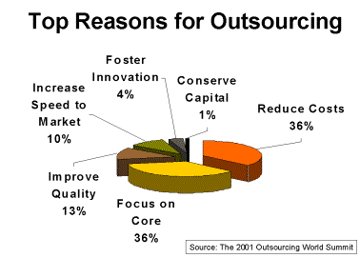
Why do Companies Outsource?

Slide 25
Reasons for Outsourcing
Traditional role - reaction to problem
  Reduction and control of costs
  Avoid large capital investment costs
  Insufficient resources available
Modern role – business strategy
  Allows company to focus on their core competencies
  Keeping up with cutting-edge technology
  Creating value for the organization and its customers
  Building partnerships

Slide 26
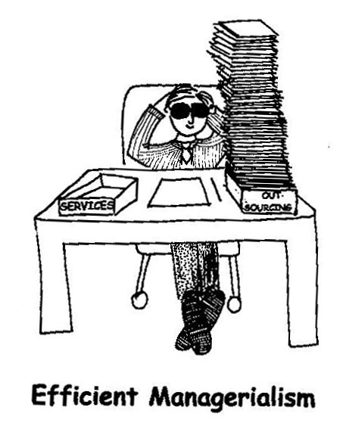
What Can be Outsourced?
system integration
data network
mainframe data center
voice network, internet/intranet
maintenance/repair
applications development
e-commerce
end-user support system

Slide 27
When to Outsource
PricewaterhouseCoopers Model
Strategic
Non-Strategic
Not
Outsourced
Grey
Area
Competitive
In House
if Possible
Outsource
Non-Competitive

Slide 28

How to Implement Outsourcing
Program initiation
  Opinions and ideas shared to form draft contract
Program implementation
  Transferring staff
  Service Level Agreement (SLA)
  Establish communications between partners
  Actual transfer of the service
  Establish management procedures
Contract agreement
Contract fulfillment

Slide 29

Problems With Outsourcing
Loss of Control
Increased cash outflow
Confidentiality and security
Selection of supplier
Too dependent on service provider
Loss of staff or moral problems
Time consuming
Provider may not understand business environment
Provider slow to react to changes in strategy

Slide 30
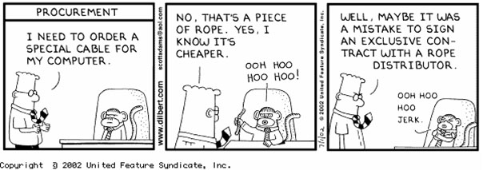
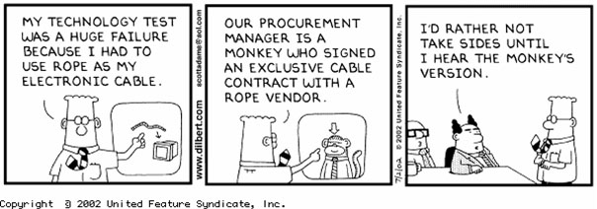
Problems With Outsourcing

Slide 31
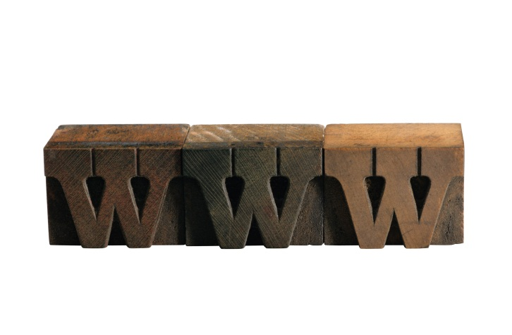
E-Commerce Hosting Solution
WAN bandwidth
IT professionals
Hardware/Software
Security issues
24/7 support

Slide 32
E-Commerce Hosting Solution
In-House
Activity costs, inclusive of labor and overhead
Raw materials, inclusive of shipping, storage, handling and overhead
Cost of invested capital
+ Estimated impact of outsourcing on costs and revenue
----------------------------------------------------------------------
Total cost of performing activity in-house
Outsource
Proposal for outsourcing
Anticipated future pricing adjustments
Additional one time costs of outsourcing
+ Additional on-going costs of outsourcing
--------------------------------------------------------------------
Total cost of outsourcing activity

Slide 33

Database Outsourcing
Areas
  Clinic
  Preventive Care
  On-going support
  Enhancement Care
Benefits
  Savings of 25% - 40%
  Pay-per-gig pricing
  Off-site data storage
  Automated
  Free up server space

Slide 34
Email Outsourcing
“The total cost of ownership for an in-house email system is likely to be in the range of $200 to $400 per user per month……. Outsourcing should reduce TCO by 10% to 30%.” Ferris Research, June 2001
Typical Services
Email Hosting
  Email@yourdomain
  POP3 access
  IMAP4 access
  Outbound SMTP
  Virus Scanning
  External POP Access
  24x7 Web-based Support
  Spell Check
  Email Forwarding
  Unlimited Attachment Size
  Unlimited Storage Folders
  Multiple attachments

Slide 35

Typical Services
Custom Webmail
  Customizable, private-label WebMail interface
  Wireless WAP Access
  Automated User Signups
  Integrated Ad Server
  Customizable to any language in the world
  Programming API's for front and back end system integration

Slide 36
Costs [2005 or earlier data]
http://www.acadea.com/WebmailPrice.htm
Web Based Email Services with POP 3 access up to 6 Mailboxes Per Month
  0-5,000 Mailboxes $0.99 each
  5,001-7,000 $0.90 each
  7,001-10,000 $0.75 each
  10,001 and up $0.55 each
Minimum Monthly Fee Per Domain is $79.00
Large Install - Setup Fee $199.00 at launch
Other Options
Wireless Access - $0.30 per mailbox per month
Outgoing SMTP - $0.20 per mailbox per month purchased in blocks of 50.
Design Services - $100 flat charge for color scheme consulting. $70 per hour for custom design consulting.
Additional Storage - Units of 2mb $0.99 per mailbox per month.
Acadea has customizable email solutions for schools, universities, government agencies and businesses.

Slide 37

Costs
Example 4: 100 User Multi Server, Multi Location Network
In-House Cost
Salary For Sr Level Network Engineer $65,000.00
Salary For Software / Hardware Support Technician $40,000.00
Medical Benefits and Payroll Expense
(assume 1 married 1 single) $ 18,100.00
Office Space and Expenses $ 10,000.00
Continuing Education $ 5,000.00
Hardware Repair Parts $ 10,500.00
=========
$148,100.00
Sullivan Data will provide on-sight technician during regular business hours for between $90,000.00 and $100,000.00 annually depending on equipment chosen
http://www.sullivandata.com

Slide 38
ECONOMICS OF SOFTWARE DEVELOPMENT
D. Cloud computing
Following slides by
Tom Greenfield
DISA Office of the CTO
Email: tom.greenfield@disa.mil
703.882.1394

Slide 39
Gordon Bell Quote
  Every decade a new, lower priced computer class forms with new programming platform, network, and interface resulting in new usage and industry.

Slide 40

What is Cloud Computing?
Multiple Choice: Cloud Computing is…
A way to access applications hosted on the web through your web browser (Software as a Service -- SaaS)
A pay-as-you-go model for IT resources accessed over the Internet (Platform as a Service – PaaS)
Use of commodity computers, distributed throughout an internet, to perform parallel processing, distributed storage, indexing and mining of data
Gartner: “Cloud computing is a style of computing where massively scalable IT-related capabilities are provided ‘as a service’ across the Internet to multiple external customers”
An IT buzzword that assures potential clients that your product is on the cutting edge of technology
All of the above

Slide 41
Common Cloud Themes
They’re big – massively scalable
Always there when you need them – on-demand, dynamic
Only use what you need – elastic, no upfront commitments, use on short term basis
Out there on the network somewhere – accessible via Internet, location independent
Transparent – complexity concealed from users, virtualized, abstracted
Service oriented – easy to use, SLAs, accessible
Simple Metaphor
Like Power Company
Better Metaphor
Cooperatively Owned
Semiconductor Fab

Slide 42
IT Trends enabling (and driven by) Cloud Computing
Increased Parallelism
  New Moore’s Law - 2X processors per chip generation
  Parallel software industries emerging to address challenges
  Redundant networks and storage increasing performance
Increased Virtualization
  Processing, Storage, Bandwidth, Delivery
Commodity Components
  X86 servers, consumer hard drives, ethernet
  Open Source SW – Freedom to customize and adapt
Increased Outsourcing of Core Elements
  “By 2012, 80 percent of Fortune 1000 companies will pay for some cloud computing service, and 30 percent of them will pay for cloud computing infrastructure.” Gartner

Slide 43













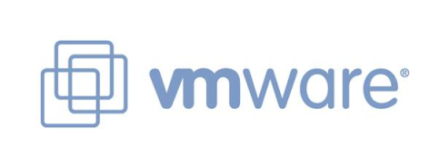




Commercial Cloud Formation

Slide 44
Cloud Deployment Models
Deployment Models:
Internal (private) cloud. The cloud infrastructure is operated within the consumer’s organization.
Community cloud. The cloud infrastructure is jointly owned by several organizations and supports a specific community that has shared concerns (e.g., mission, security requirements, policy, and compliance considerations).
Public cloud. The cloud infrastructure is owned by an organization selling cloud services to the general public or to a large industry group.
Hybrid cloud. The cloud infrastructure is a composition of two or more clouds (internal, community, or public) that remain unique entities but are bound together by standardized or proprietary technology that enables data and application portability.
NIST working definitions

Slide 45
Business Case for Cloud Computing
Automation/On-Demand = Better, Faster & Cheaper
Moving from ‘hand crafted’ software to repeatable assembly
Reuse of interchangeable components
Repeatable processes with increased automation & collaboration
Division of labor – let developers focus on new software
Ease of use – abstract complexity out of developers’ lives
Avoid over & under provisioning – CAPEX outlays
Data Intensive Computing
Ability to index and make sense of large data sets – parallization
Pre-format data in large repositories for low BW transmissions
Better access to data with large multi-tenant distributed cloud databases
Default backup and most cost effective archival of large data sets.
Accessibility = Any time, any place, any device
Cloud serviced clients
Leverage low cost compute cycles and assured data storage in the cloud
Communications is pacing factor
Challenge is to balance platform agnostic vs. end point device innovations

Slide 46


Ease of Assembly - Fabrication
Assembly Line – Muskets -> Ford 1815 | Cloud SW Development & Deployment, Data Fusion 2009
Interchangeable parts, engineering tolerances | Interchangeable abstracted resources, reuse of SW components, web service standards
New materials handling processes | Repeatable SW development CM processes with increased automation & collaboration
Division of labor, specialization | Let SW developers focus on value add new functionality, let others focus on repeatable hosting and underlying platform tasks
Put skills in the machines, enabling use of semi-skilled rural work force | Abstract complexity away from developers & users (virtualization, widgets, open APIs)
Moving from hand crafted -> repeatable assembly.

Slide 47
Cloud Related Service Offerings
Cloud Market Types | Types of Offerings | Examples
Software-as-a-Service | Rich Internet application web sites Application as Web Sites Collaboration and email Office Productivity Client apps that connect to services in the cloud | Flikr Myspace.com Cisco WebEx office Gmail IBM Bluehouse
App-components -as-a-Service | APIs for specific service access for integration Web-based software service than can combine to create new services, as in a mashup | Amazon Flexible Payments Service and DevPay Salesforce.com’s AppExchange Yahoo! Maps API Google Calendar API zembly
Software-platform-as-a-Service | Development-platform-as-a-service Database Message Queue App Servicer Blob or object data stores | Google App Engine and BigTable Microsoft SQL Server Data Services Engine Yard Salesforce.com’s Force.com
Virtual Infrastructure-as-a-Service | Virtual servers Logical disks VLAN networks Systems Management | Akamai Amazon EC2 CohesiveFT Mosso (from Rackspace) Joyent Accelerators Nirvanix Storage Delivery Network
Physical Infrastructure | Managed Hosting Collocation Internet Service Provider Unmanaged hosting | GoDaddy.com Rackspace Savvis
 |  | Adapted from Forrester Research Taxonomy
Level of
Abstraction

Slide 48
Q: Where is DISA’s Cloud Focus?
A: Infrastructure/Platform Capabilities
Customers
Software-as-a-Service
Existing end user services market, delivered from/off the cloud
End users
App-components-as-a-service
Three emerging cloud-infrastructure -as-a-service markets
Software-platform-as-a-service
IT Consumers
Virtual-Infrastructure-as-a-Service
Physical infrastructure
Traditional data center services market, such as collocation or managed hosting

Slide 49
DISA Portfolio of Efforts
Button 1 ECollab
Button 2 DCO
UCC Button 3 (planned)
Enterprise Email (planned)
Software-as-a-Service
Increased Programmer Convenience
App-components-as-a-service
NSLDSS
JackBe
(JCTD)
Forge.mil
Software-platform-as-a-service
Virtual-Infrastructure-as-a-Service
RACE
Increased Flexibility
Delivery to Edge
DECC Hosting
Capacity on Demand
Physical infrastructure
Notes:
JackBe – DIA/DISA CIO exchange – used in ICDL and DIA Home Page

Slide 50
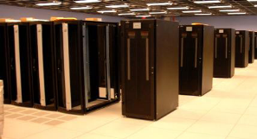







Extending the Cloud to Deployed Users
DISA Delivery Efforts
GCDS Akamai
EFDS
JIPM
TSP/GBS
IW
PS4
UVDS
Consumer RIA Clients
Web
Services
User-hosted Caches
Fixed Sites
Rich
Web-based
Access
Cloud
CDN/WOA/PEPs
RIA
Synchronization
Low BW protocols
Remote/Mobile
Access
Diverse Users
Diverse
Infrastructures
Track - Wednesday, April 22, 3:00-4:30 PM PEO-GES Accelerating and Optimizing the Delivery of Information
Track – Friday, April 24 8:00 – 9:00AM PEO-GES GIG Content Delivery Service and EFD Workshop
Track - Tuesday, April 21 4:30-5:30 PM PEO-STS Joint IP Modem (JIPM)
Track – Wednesday, April 22, 3:00-4:30 PM PEO-STS Joint IP Modem (JIPM)
Notes:
GCDS: GIG Content Delivery Service
EFDS: Enterprise File Delivery Service
JIPM
TSP/GBS
IW
PS4
UVDS – Unified Video Delivey Service
Consumer RIA Clients

Slide 51
CTO Cloud Research
Areas of Interest
Automated Dev -> Test -> Production Capabilities
Data Clouds
  Applicability of cloud “shared nothing” databases to C2 app challenges
  Common structured data stores handling multiple data models
Utility Computing Programming Models for Production Environments
Common Edge Caching & Acceleration Techniques
Cloud serviced client platforms
  Enterprise Mashups: Shindig/GWT, JackBe Presto
  Geo-visualization – NASA Worldwind
  Mediaplayers – VLC
  Mobile computing
  Virtual Desktop Infrastructure (VDI) soft & hard thin clients
Common HW Infrastructure Templates & Data Center Practices

Slide 52
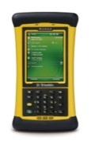



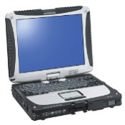


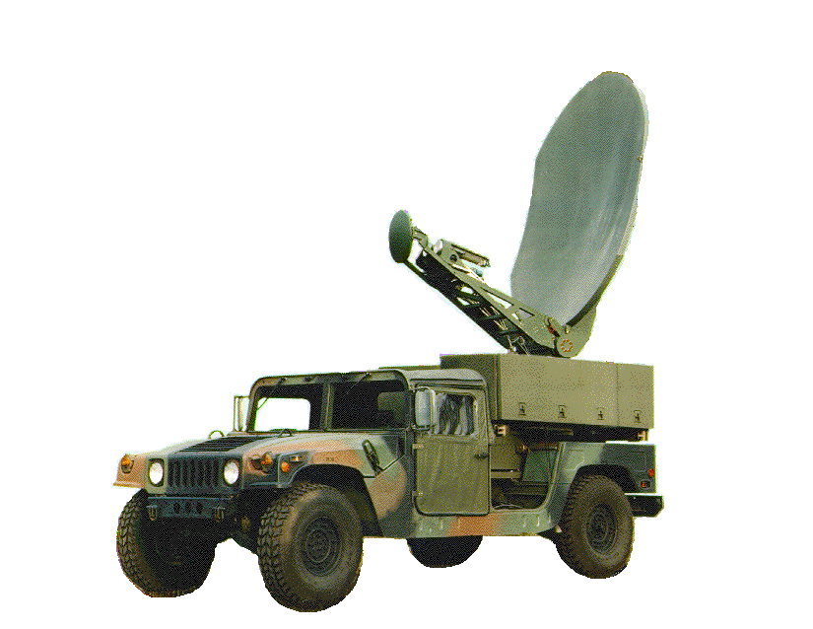


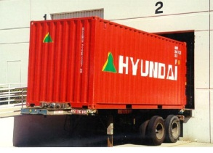
A Vision
Plug-n-Fight
Enterprise Tactical Content Delivery Network
Device RIA
Clients
Fixed Geo-redundant
Data Centers
SIPRNet
Deployable
Data Center
Do for Computing what IP did for Networks
Cloud = default background resource

Slide 53


Slide 54
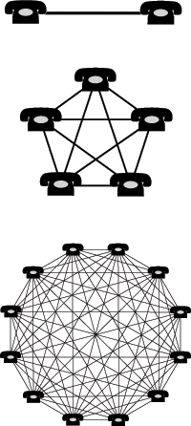
Increasing the Value of “our” Cloud
Clouds Exhibit Network Effect
More participation increases value of the system to everyone
More indexed data = greater opportunity to uncover patterns & make connections
More participation in collaborative SW development = increased contributions of reusable code
More design interactions = more seamless interfaces and lower friction processes
More use = greater statistical multiplexing of loads = increased ability for surge computing
More use = more machines = better economies of scale

